Slide 1
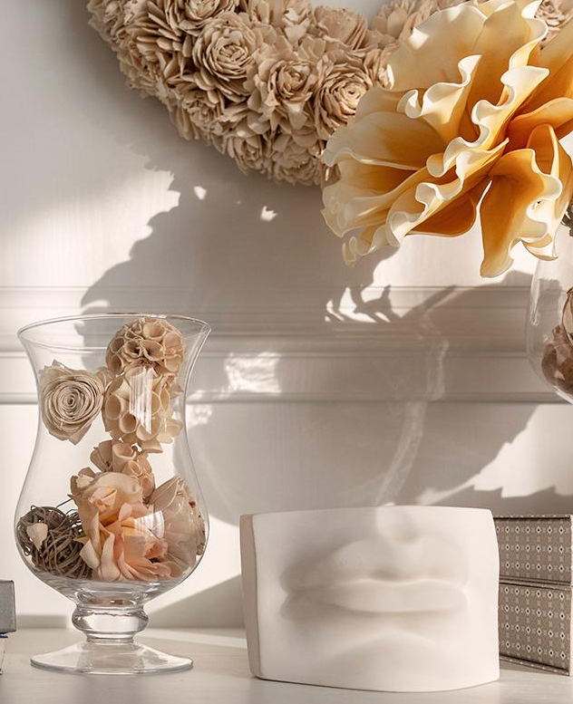
Hotel Reservation
BY: Habiba Mohammad Atiia

Slide 2
Overview
The hotel industry leverages data to make informed decisions and enhance the guest experience. I have worked with a hotel reservation dataset to gain insights into guest preferences, booking trends, and other critical factors that influence hotel operations. Using SQL, I have queried and analyzed the data to answer specific questions about the dataset.

Slide 3
Dataset Details
- includes the following columns:
Booking_ID
no_of_adults
no_of_children
no_of_weekend_nights
no_of_week_nights
type_of_meal_plan
room_type_reserved
lead_time
arrival_date
market_segment_type
avg_price_per_room
booking_status

Slide 4

Q1
What is the total number of reservations in the dataset?
Enjoy your time

Slide 5
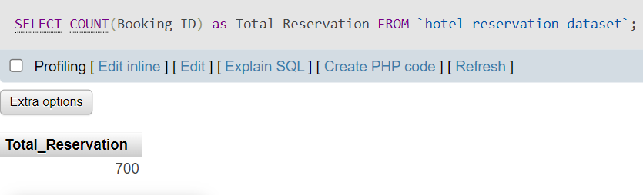

Slide 6
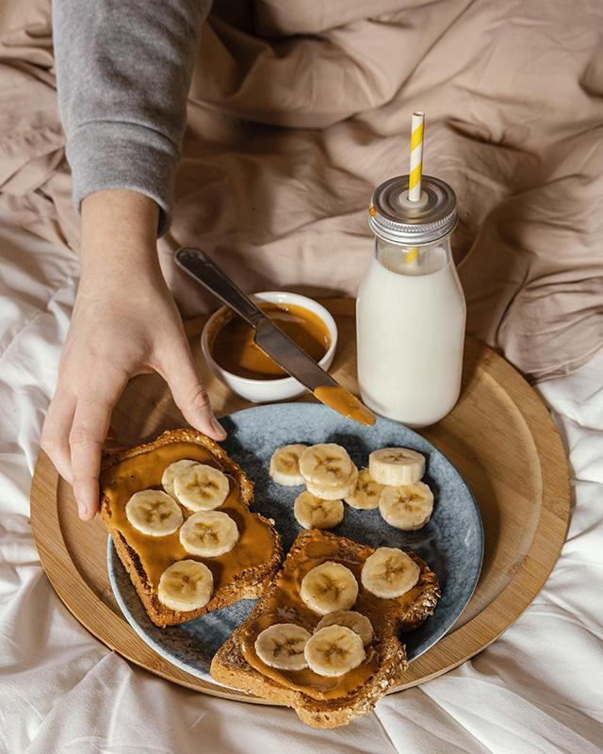
Q2
Which meal plan is the most popular among guests?
Our best option

Slide 7
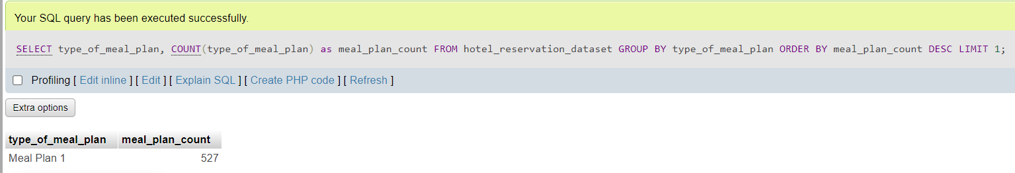

Slide 8
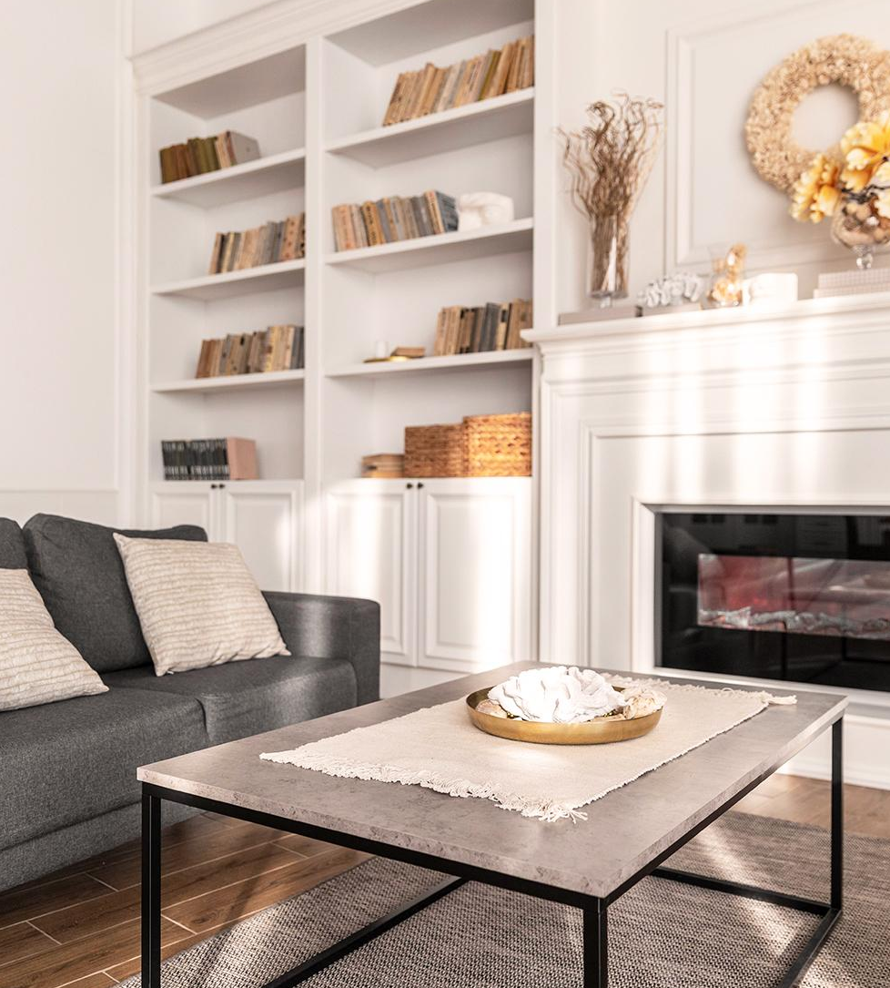
Q3
What is the average price per room for reservations involving children?

Slide 9
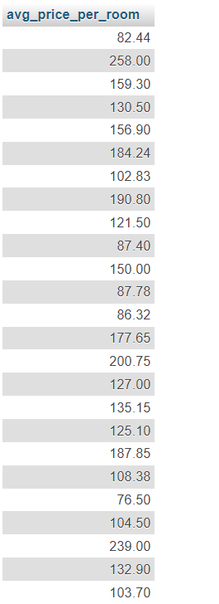
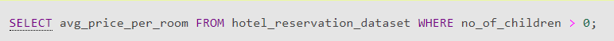

Slide 10
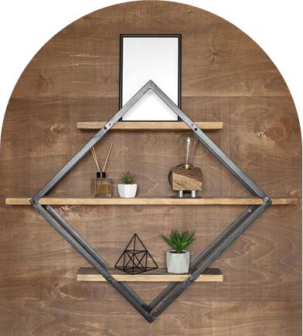
Q4
How many reservations were made for the year 2017 or 2018?

Slide 11
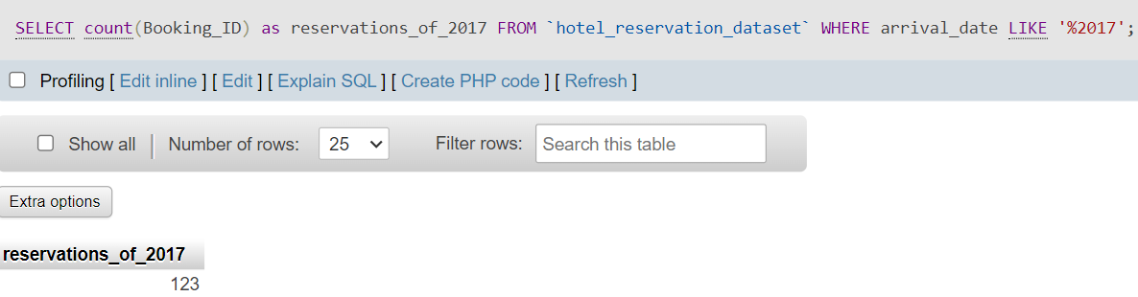

Slide 12
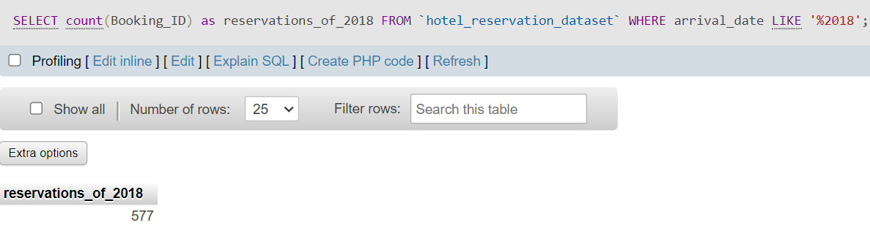

Slide 13
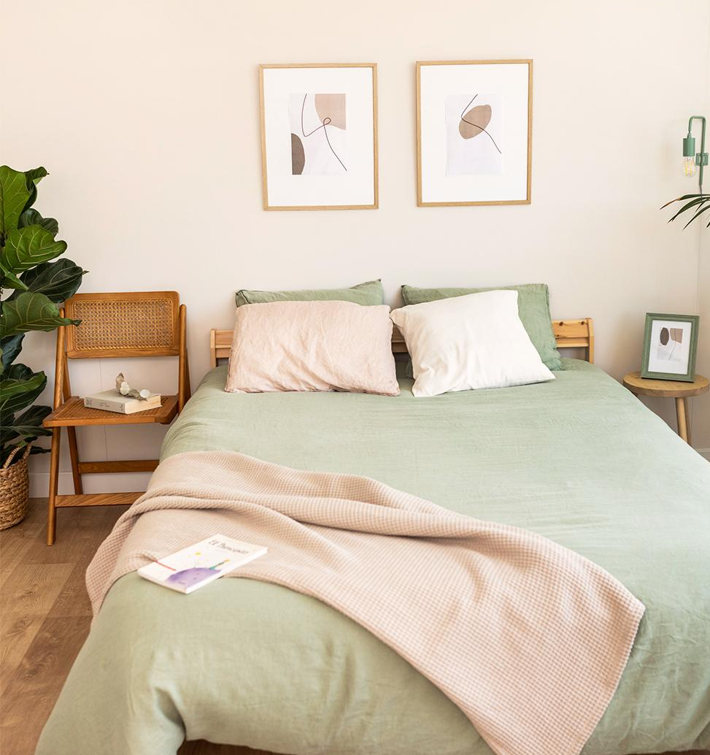
Q5
What is the most commonly booked room type?

Slide 14
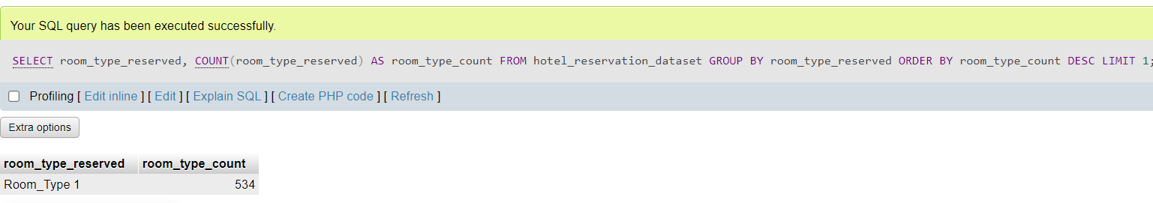

Slide 15

Q6
How many reservations fall on a weekend?

Slide 16
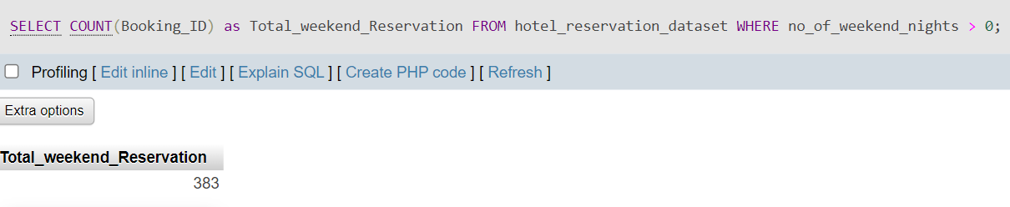

Slide 17
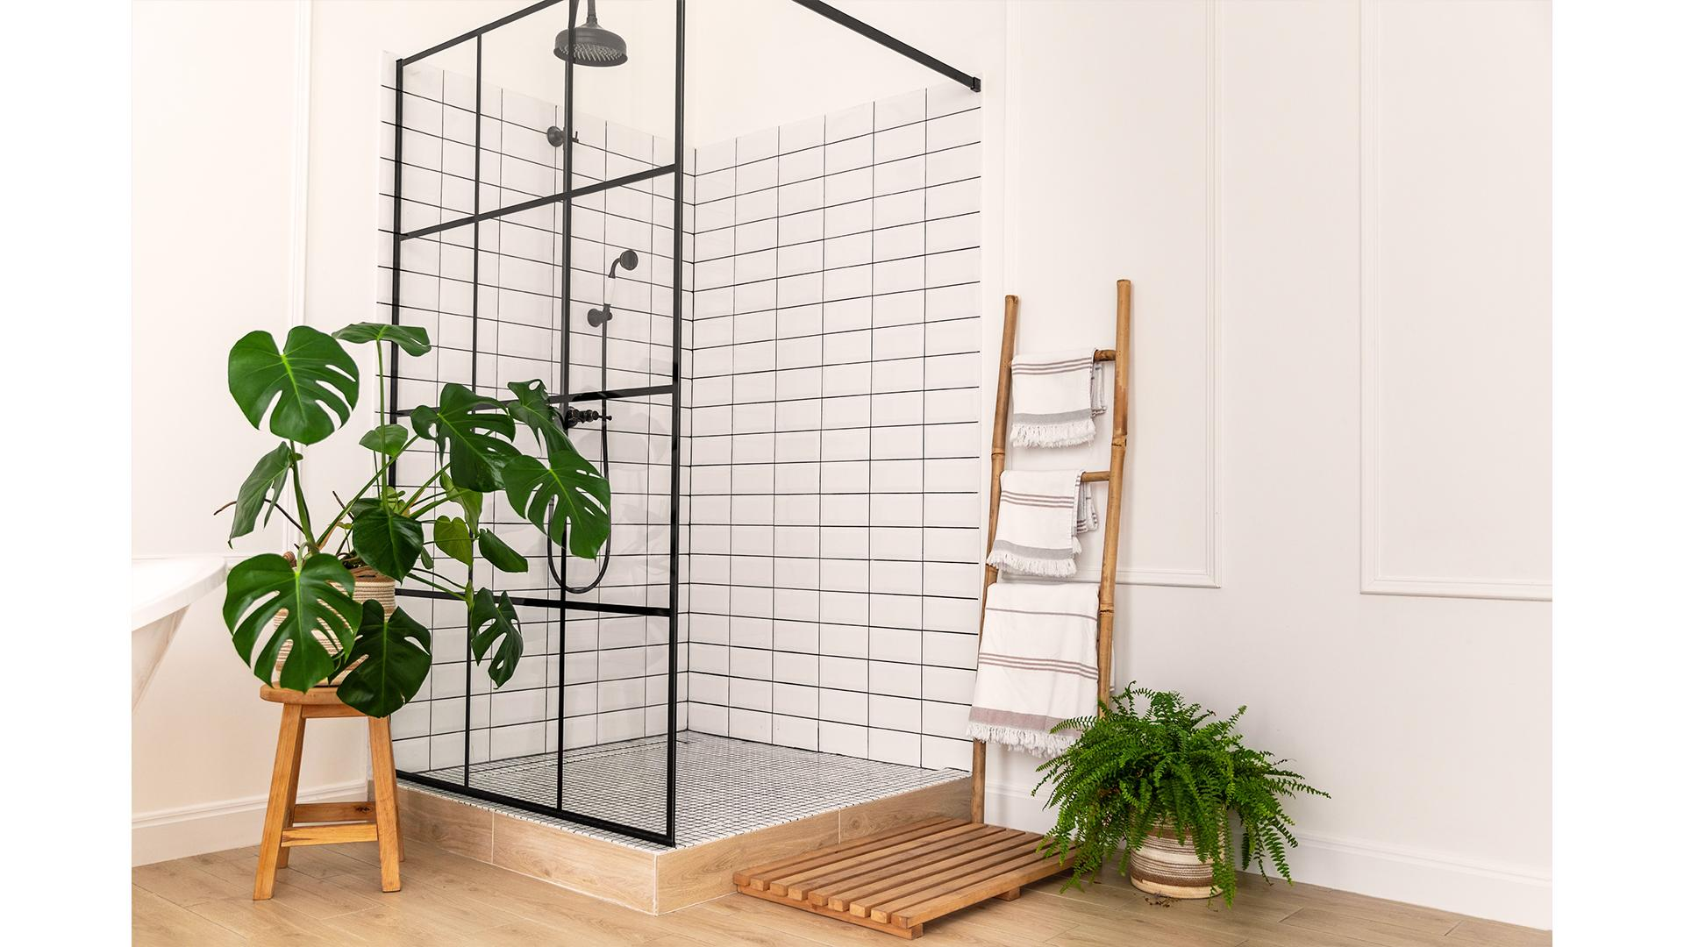
Q7
What is the highest and lowest lead time for reservations?

Slide 18
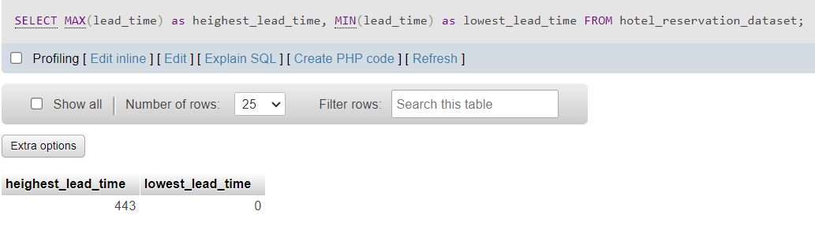

Slide 19

Q8
What is the most common market segment type for reservations?

Slide 20
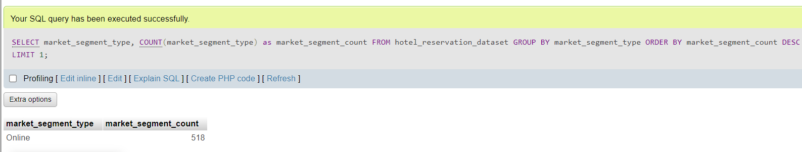

Slide 21
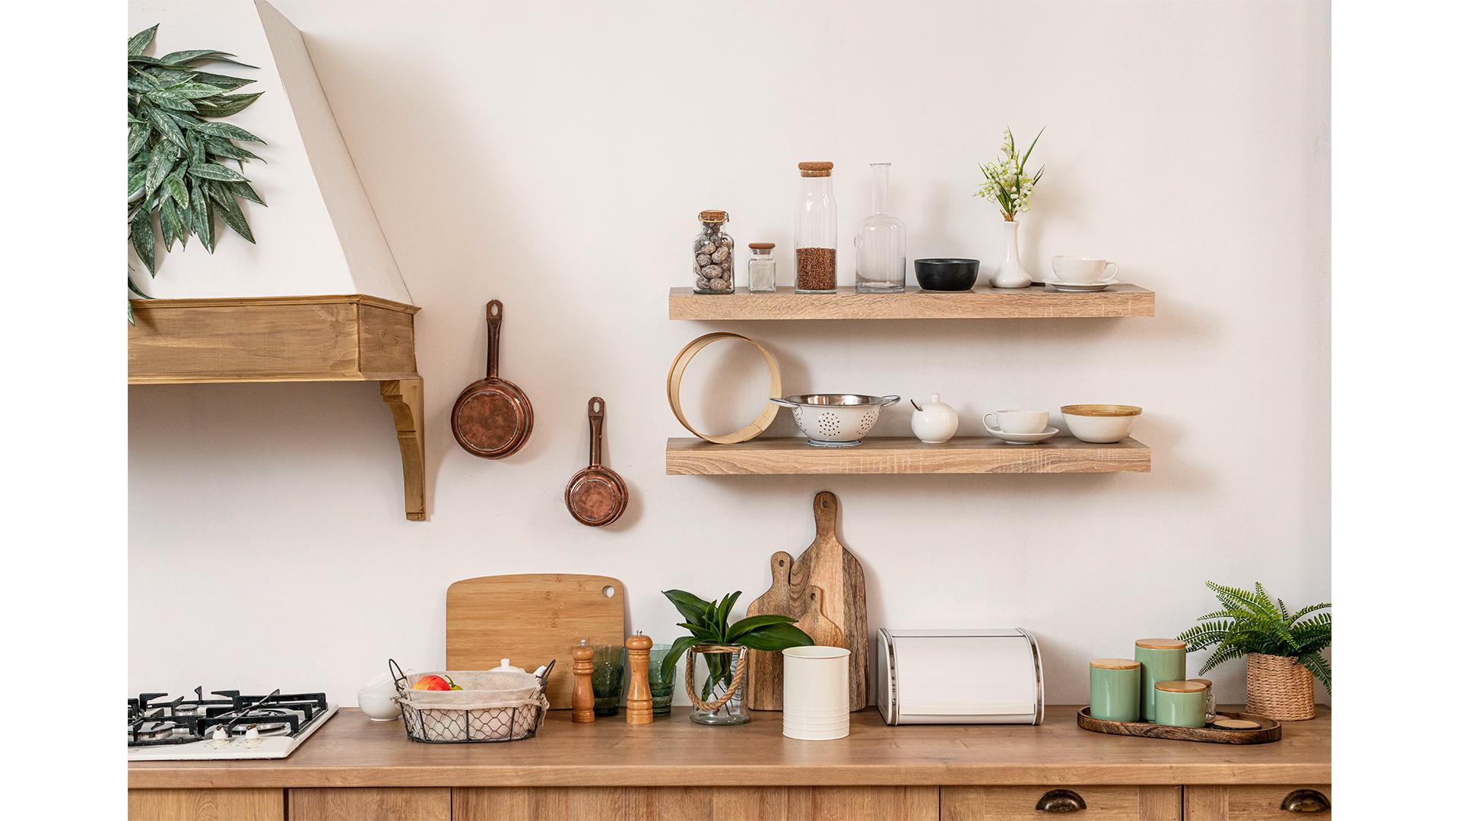
Q9
How many reservations have a booking status of "Confirmed"?

Slide 22
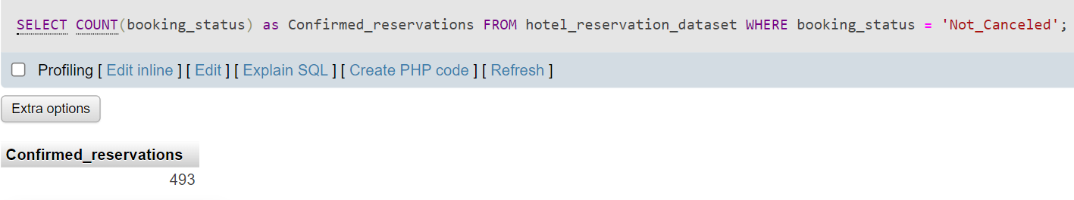

Slide 23

Q10
What is the total number of adults and children across all reservations?

Slide 24
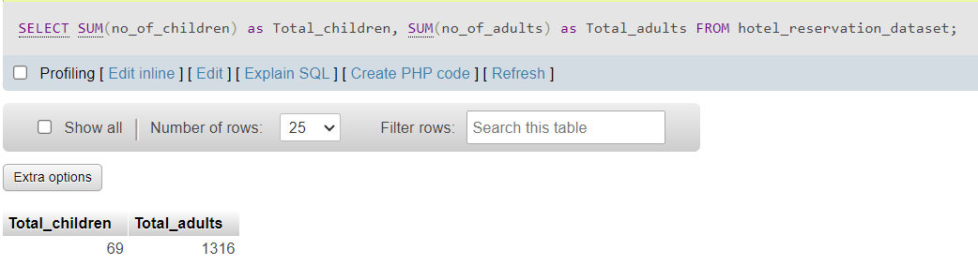

Slide 25

Q11
What is the average number of weekend nights for reservations involving children?

Slide 26
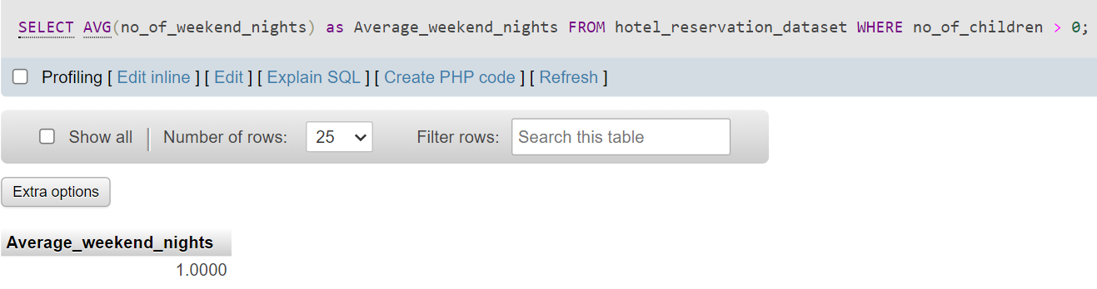

Slide 27
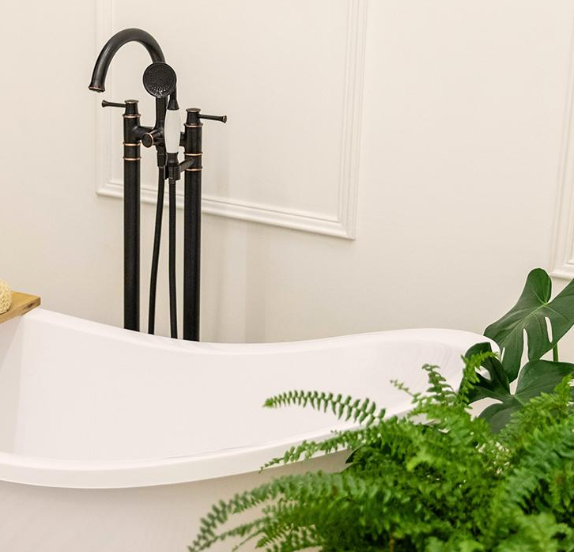
Q12
How many reservations were made in each month of the year?

Slide 28
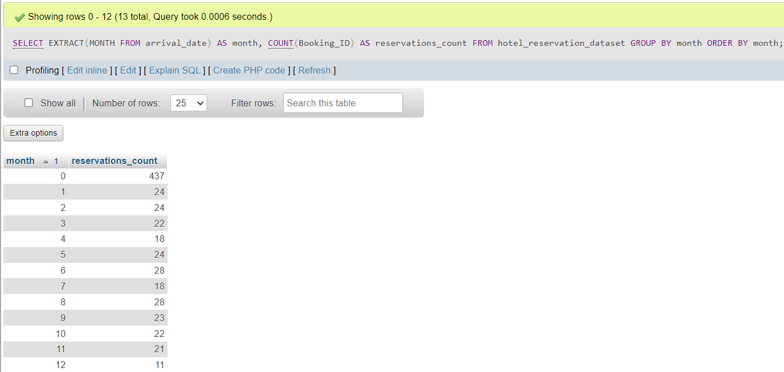

Slide 29
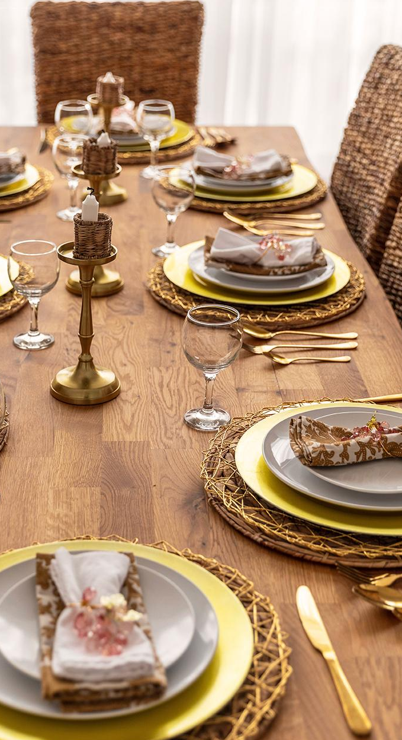
Q13
What is the average number of nights (both weekend and weekday) spent by guests for each room
type?

Slide 30
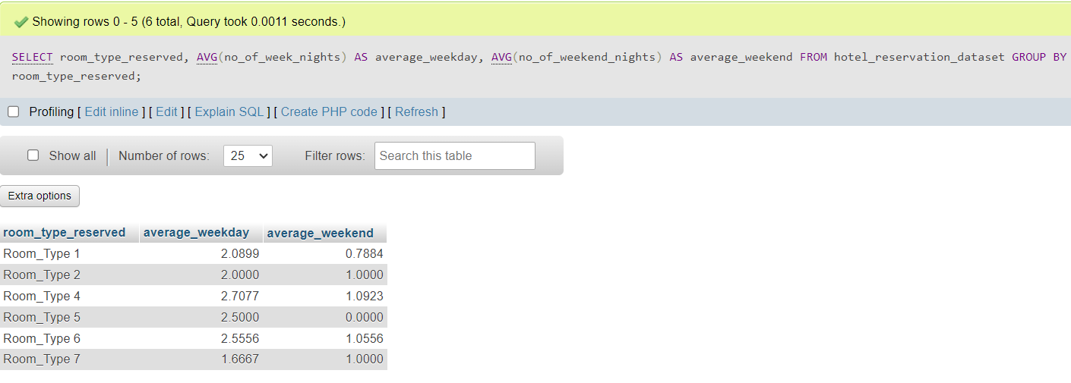

Slide 31
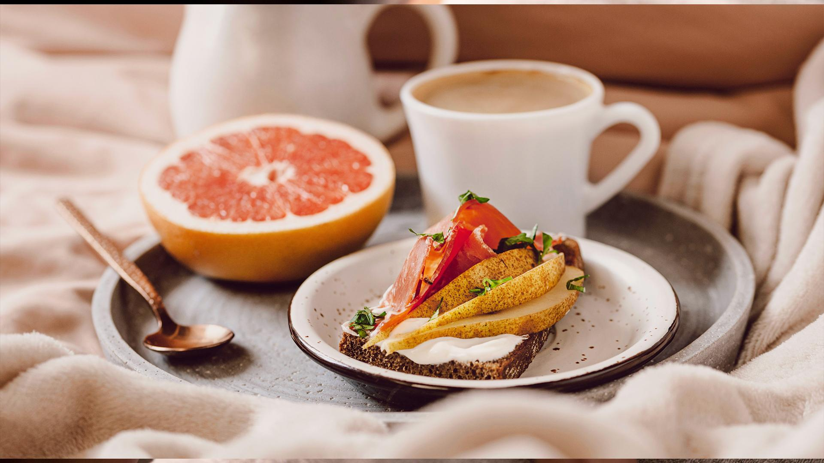
Q14
For reservations involving children, what is the most common room type, and what is the average price for that room type?

Slide 32
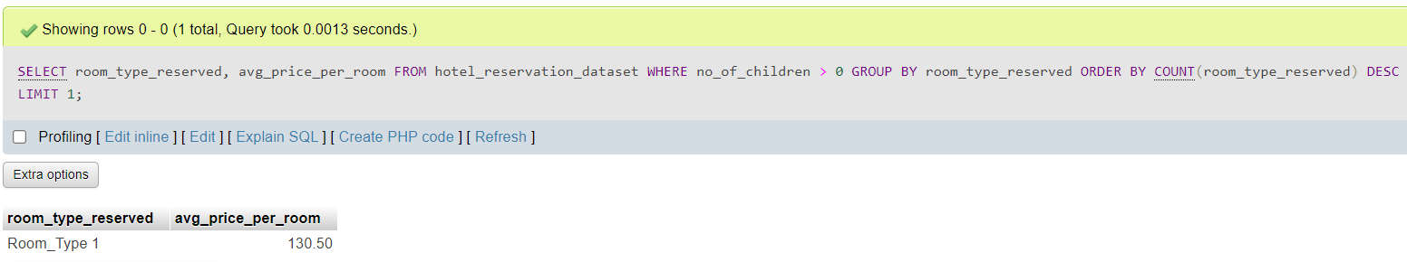

Slide 33

Q15
Find the market segment type that generates the highest average price per room.

Slide 34
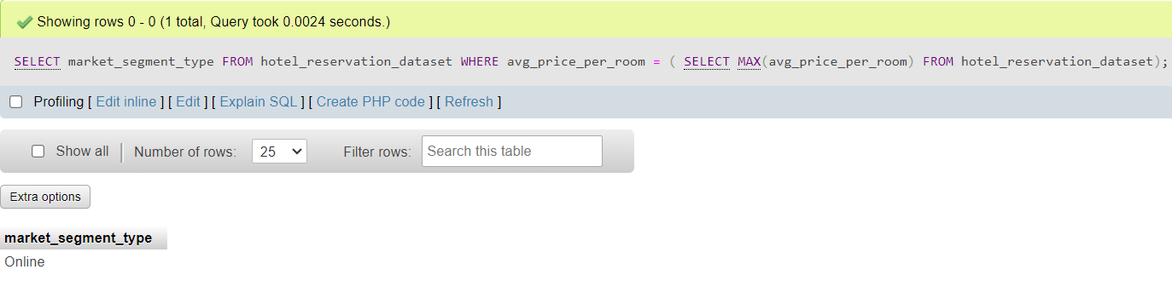

Slide 35
Insights and Findings
The most popular meal plan among guests is meal plan 1.
The number of reservations were made for the year 2018 are extremely more than 2017.
The most commonly booked room type is room type 1.
The number of reservations fall on a weekend are 383.
The highest lead time for reservations is 443 and the lowest is 0.
The most common market segment type for reservations is the Online type.
The number of reservations have a booking status of “Confirmed” are 493.
The total number of adults is 1316 and the total number of children is 69 across all reservations.
The average number of weekend nights for reservations involving children is 1.
For reservations involving children, the most common room type is room type 1 , and the average price is 130.50.

Slide 36
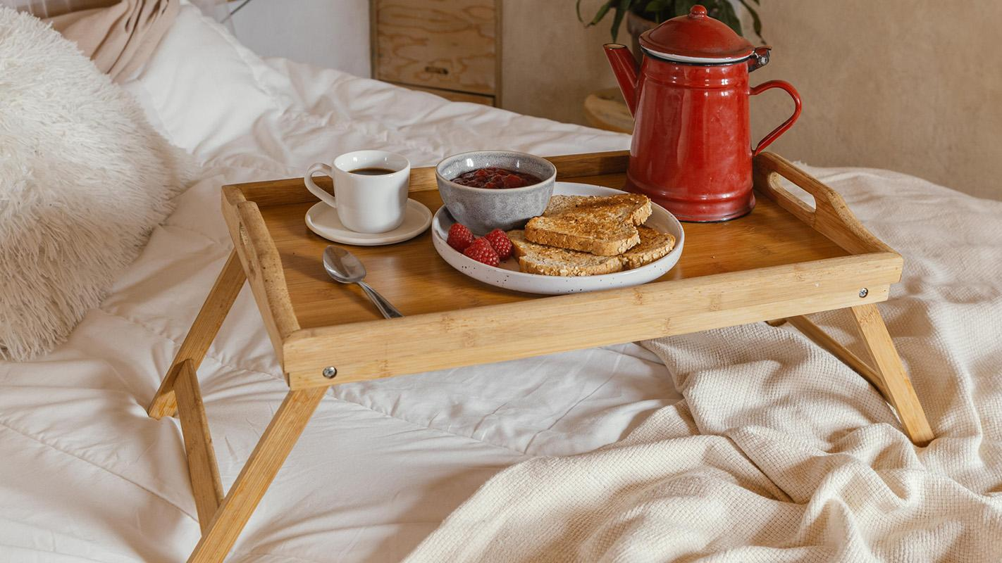
Thank You

